Slide 1







Consumer Goods Ad Hoc Insights
-By Harsha S S

Slide 2
ROADMAP
ABOUT THE COMPANY
DESCRIPTION OF THE DATASET
PROBLEM & OBJECTIVE
QUERIES WITH INSIGHTS

Slide 3


ABOUT THE COMPANY
Atliq Hardware is an imaginary company and a leading manufacturer of computer hardware, operating in India and 26 other countries.
The company produces a wide range of products under three divisions: Peripherals & Accessories, Personal Computers, and Networking & Storage.
Serving 74 diverse customers, Atliq Hardware symbolizes global innovation and technological excellence.
Fiscal year starts in Sept and ends in Aug.

Slide 4
Market Presence: Platforms of Operation
Brick & Mortar
E-Commerce

Slide 5
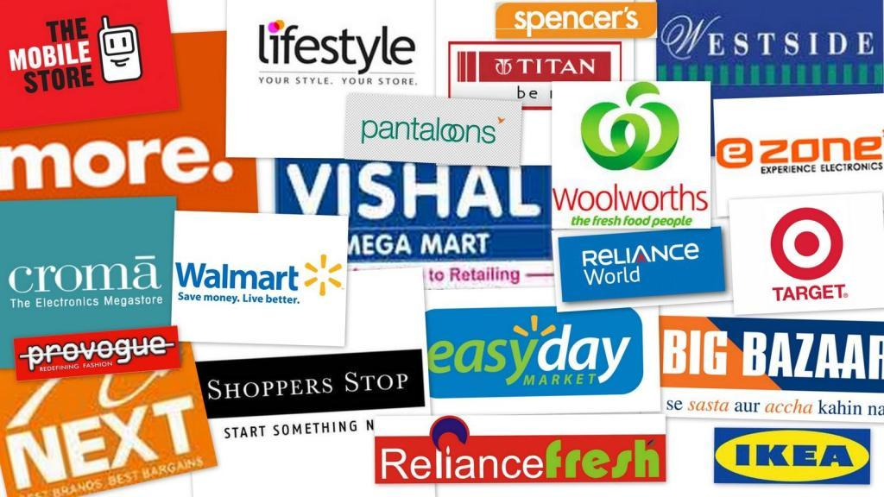


Distribution Channels Overview
Retailer
Direct
Distributor
E-store &Exclusive

Slide 6
DESCRIPTION OF DATASET
The dataset is sourced from the Atliq Hardware database, comprising six main tables.
It includes information on:
dim customer
dim product
fact_gross_price
fact_manufacturing_cost
fact_pre_invoice_deductions
fact_sales_monthly
Covers fiscal years 2018 to 2022, providing detailed business insights.

Slide 7
PROBLEM
AtliQ Hardware faces challenges in addressing business queries promptly due to the constraints of its existing reporting tools.
These limitations result in delays in making data-driven decisions in critical areas like sales, finance, and supply chain.
To address this, 10 ad-hoc requests have been assigned to the data analyst for actionable insights.

Slide 8
OBJECTIVE
The primary objective of this project is to provide actionable insights to Atliq Hardware's management team through in-depth data analysis. By leveraging SQL ,Excel and Power BI, the project aims to:
Uncover key business trends and patterns to support strategic decision-making.
Assist in identifying areas for improvement to optimize sales, performance, and customer engagement.
Enable data-driven decisions that drive business growth and scalability across global markets.

Slide 9
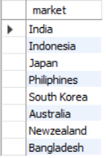
Request 1: Provide the list of markets in which customer "Atliq Exclusive" operates its business in the APAC region.
select
distinct market
from dim_customer
Where
customer="Atliq Exclusive“
and
region ="APAC"
Query
Query Result

Slide 10
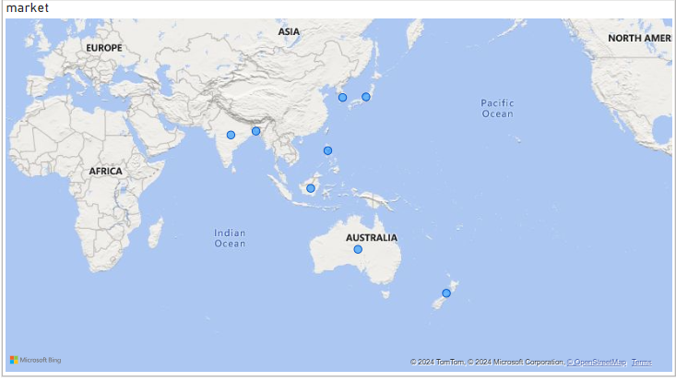
Insights
“Atliq Exclusive" is active in 8 in the APAC region, showing its strong presence and reach across multiple markets.
There may be opportunities to expand into new APAC countries where the brand is not yet present.

Slide 11

Request 2: What is the percentage of unique product increase in 2021 vs. 2020? The final output contains these fields : unique_products_2020 unique_products_2021 percentage_chg
36.3%
SELECT
COUNT(DISTINCT CASE WHEN fiscal_year = 2020 THEN product_code END) AS unique_products_2020,
COUNT(DISTINCT CASE WHEN fiscal_year = 2021 THEN product_code END) AS unique_products_2021,
ROUND( (COUNT(DISTINCT CASE WHEN fiscal_year = 2021 THEN product_code END) - COUNT(DISTINCT CASE WHEN fiscal_year = 2020 THEN product_code END)) * 100 / COUNT(DISTINCT CASE WHEN fiscal_year= 2020 THEN product_code END), 2) AS percentage_chg
FROM
dim_product p
left join
fact_sales_monthly s
using(product_code);
Query
Query Result

Slide 12
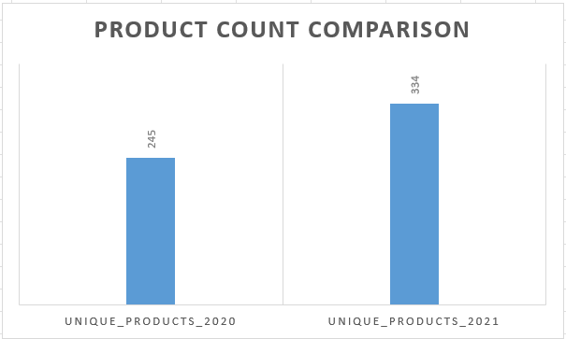
Insights
A 36.3% increase in unique products indicates the company's focus on research, development, and product innovation, resulting in the launch of new offerings in the market.
This growth may also reflect expansion into new markets or efforts to attract diverse customer segments with a wider product range, highlighting the need to strengthen supply chain and inventory management.

Slide 13
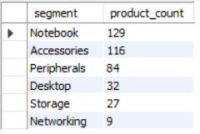
Request 3: Provide a report with all the unique product counts for each segment and sort them in descending order of product counts. The final output contains two fields : segment product_count
Select
segment,
count(distinct product_code) as product_count
from
dim_product
group by segment
order by product_count desc
Query
Query Result

Slide 14
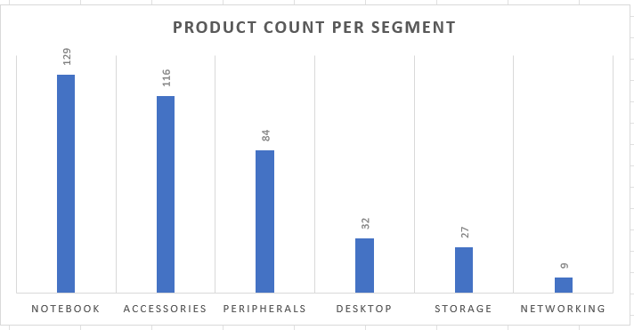
Insights
Notebooks have the most products, indicating they are the main focus.
Accessories and Peripherals are key categories, supporting primary products.
Networking has the fewest products, suggesting it’s a less prioritized segment.

Slide 15
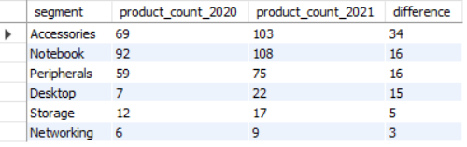
Request 4: Which segment had the most increase in unique products in 2021 vs 2020? The final output contains these fields : segment product_count_2020 product_count_2021 difference
Query
SELECT
segment,
COUNT(DISTINCT CASE WHEN fiscal_year = 2020 THEN product_code END) AS product_count_2020,
COUNT(DISTINCT CASE WHEN fiscal_year = 2021 THEN product_code END) AS product_count_2021,
COUNT(DISTINCT CASE WHEN fiscal_year = 2021 THEN product_code END) - COUNT(DISTINCT CASE WHEN fiscal_year = 2020 THEN product_code END) AS difference
FROM
dim_product p
LEFT JOIN
fact_sales_monthly s
USING (product_code)
group by segment
order by difference desc;
Query Result

Slide 16
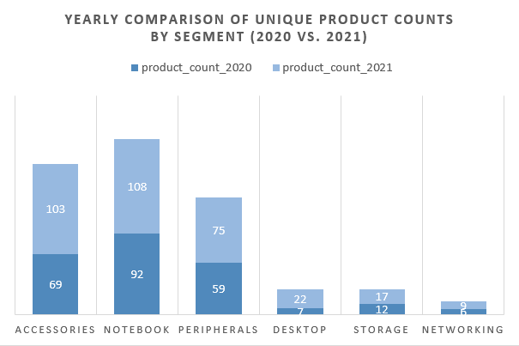
Accessories experienced the highest growth, with an increase of 34 unique products, reflecting strong demand and diversification.
Notebooks and Peripherals grew steadily, each adding 16 products, indicating consistent expansion.
Desktop, though smaller, added 15 products, suggesting potential demand for gaming or work-from-home setups.
Networking and Storage showed minimal growth, with increases of 3 and 5 products, possibly due to market saturation or lower priority.
Insights

Slide 17

Request 5: Get the products that have the highest and lowest manufacturing costs. The final output should contain these fields: product_code product manufacturing_cost
Query
select
product_code,
product,
manufacturing_cost
from
dim_product p
left join
fact_manufacturing_cost m
using(product_code)
where
manufacturing_cost = (select max(manufacturing_cost)
from fact_manufacturing_cost)
or
manufacturing_cost = (select min(manufacturing_cost)
from fact_manufacturing_cost)
order by manufacturing_cost desc
Query Result

Slide 18
Products with Highest Manufacturing Cost:
The product with the maximum manufacturing cost represents either a highly premium product or one that involves expensive materials or complex production processes.
You could analyze the profit margins for this product and evaluate whether the high manufacturing cost is justified by its selling price and market demand.
Products with Lowest Manufacturing Cost:
The product with the minimum manufacturing cost likely represents a budget product or a simple design with inexpensive materials.
These products may contribute to higher sales volume due to affordability. It's worth checking whether they play a role in generating overall revenue despite low margins.
Insights

Slide 19
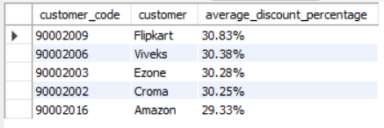
Request 6: Generate a report which contains the top 5 customers who received an average high pre_invoice_discount_pct for the fiscal year 2021 and in the Indian market. The final output contains these fields : customer_code customer average_discount_percentage
Select
customer_code,
customer,
concat(round(avg(pre_invoice_discount_pct)*100,2),'%') as average_discount_percentage
from
dim_customer c
left join
fact_pre_invoice_deductions pre
using(customer_code)
where
fiscal_year=2021
and
market="india"
group by customer_code, customer
order by avg(pre_invoice_discount_pct) desc
limit 5
Query
Query Result

Slide 20
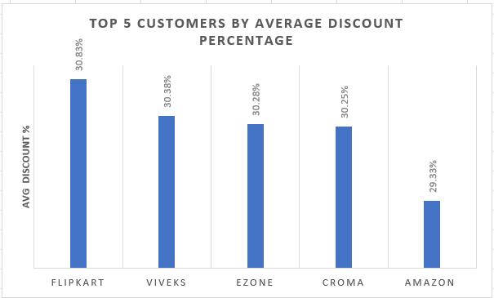
Insights
Flipkart received the highest average discount (30.83%), showing its strong negotiating power.
Viveks, Ezone, and Croma had similar discounts, all around 30%.
Amazon received a slightly lower discount (29.33%) compared to others in the top 5.
High discounts indicate a focus on competitive pricing in the Indian market.
The company should analyze the ROI of these discounts and identify strategies to balance profitability while maintaining strong customer relationships.

Slide 21
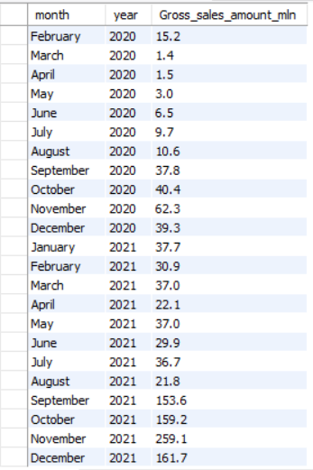
Request 7: Get the complete report of the Gross sales amount for the customer “Atliq Exclusive” for each month . This analysis helps to get an idea of low and high-performing months and take strategic decisions. The final report contains these columns: Month Year Gross sales Amount
Query Result
Select
monthname(date) as month,
year(date) as year, round(sum(gross_price*sold_quantity)/1000000,1) as Gross_sales_amount_mln
from
fact_sales_monthly s
join
fact_gross_price g
using(product_code)
join
dim_customer c
using(customer_code)
where
customer='Atliq Exclusive’
group by
monthname(date),
year(date)
order by year(date)
Query

Slide 22
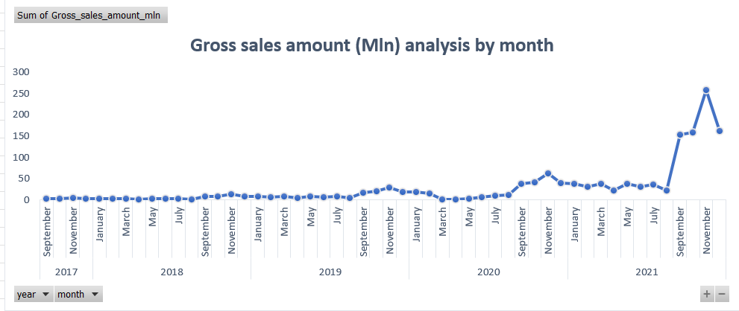
Insights
November 2021 had the highest sales (259.1 million), with strong performances in October and September 2021.
April 2018 and March 2020 had the lowest sales, likely due to seasonal slumps or external factors like COVID-19.
Sales showed significant growth from 2019 onward, with 2021 being a standout year in performance.
The company should focus on replicating successful strategies from high-performing months and enhance marketing efforts during weaker months to sustain growth.

Slide 23
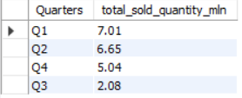
Request 8: In which quarter of 2020, got the maximum total_sold_quantity? The final output contains these fields sorted by the total_sold_quantity, Quarters total_sold_quantity.
select
case WHEN month(date) in (9,10,11) then 'Q1’
WHEN month(date) in (12,1,2) then 'Q2'
WHEN month(date) in (3,4,5) then 'Q3'
WHEN month(date) in (6,7,8) then 'Q4' end as Quarters , round( sum(sold_quantity)/1000000 ,2) as
total_sold_quantity_mln
from
fact_sales_monthly
where
fiscal_year=2020
group by Quarters
order by total_sold_quantity_mln desc
Query
Query Result

Slide 24
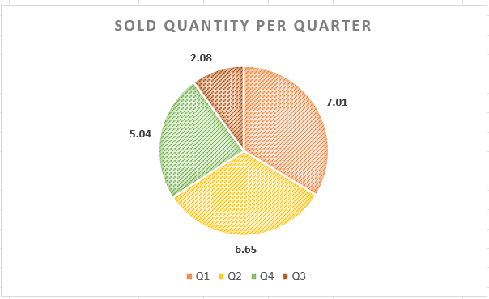
Q1 (7.01M units): Highest sales, possibly due to festivals or holiday shopping in September-November.
Q2 (6.65M units): Strong sales, influenced by year-end holidays and New Year promotions.
Q4 (5.04M units): Sales showed a moderate recovery post-pandemic disruption.
Q3 (2.08M units): Lowest sales, likely affected by the pandemic's onset (March-May).
Seasonal promotions and festive campaigns seem to work well in Q1 and Q2.
Mid-year sales patterns in Q3 could be explored further to understand potential gaps.
Identifying factors behind the Q4 recovery could provide insights into sustaining momentum.
Insights

Slide 25

Request 9: Which channel helped to bring more gross sales in the fiscal year 2021 and the percentage of contribution? The final output contains these fields : channel gross_sales_mln percentage
Query
WITH cte1 AS
( SELECT
channel,
SUM(gross_price * sold_quantity) AS gross_sales, SUM(SUM(gross_price * sold_quantity)) OVER () AS total_gross_sales
FROM
fact_sales_monthly s
left JOIN
fact_gross_price g
USING (product_code)
left JOIN
dim_customer c
USING (customer_code)
where
s.fiscal_year=2021
GROUP BY channel )
SELECT
channel,
ROUND(gross_sales / 1e6, 2) AS gross_sales_mln, CONCAT(ROUND(gross_sales * 100.0 / total_gross_sales, 2), '%') AS percentage
FROM cte1
ORDER BY gross_sales DESC;
Query Result

Slide 26
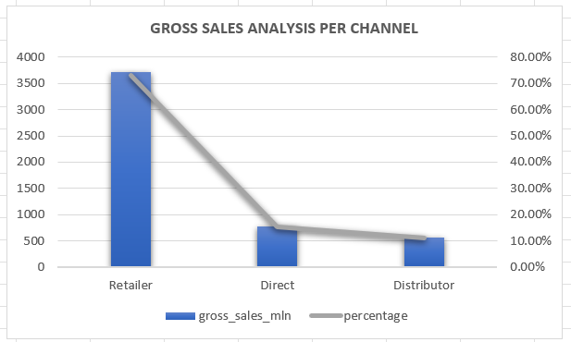
Retailers continue to play a critical role, with a strong online and physical presence.
Direct sales through AtliQ's own stores remain an important avenue for engaging with end consumers, possibly with potential for growth.
Distributor channels, though smaller, help AtliQ reach markets where direct sales are not feasible, highlighting the importance of B2B relationships in global expansion.
Insights

Slide 27
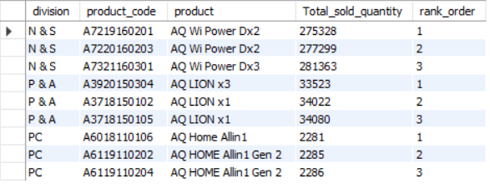
Request 10: Get the Top 3 products in each division that have a high total_sold_quantity in the fiscal_year 2021? The final output contains these fields : division product_code product total_sold_quantity rank order
Query
with cte1 as
(select
division,
product_code,
product,
sum(sold_quantity) as Total_sold_quantity,
rank( ) over ( partition by division order by sum(sold_quantity)) as rank_order
from
dim_product p
left join
fact_sales_monthly s
using(product_code)
where
fiscal_year=2021
group by
division,
product_code,
product )
select
division, product_code , product,
Total_sold_quantity , rank_order
from cte1
where rank_order<=3
Query Result

Slide 28
THANKYOU♥️

